Slide 1
Building the most effective soccer team
Student: Henrik Sergoyan
Instructor: Habet Madoyan

Slide 2
£ 56m

Slide 3
£ 54.4m

Slide 4
Outline
Data Scraping
Data Preparation
Optimization
Shiny Application

Slide 5
Data Scraping
www.whoscored.com
www.transfermarkt.com

Slide 6
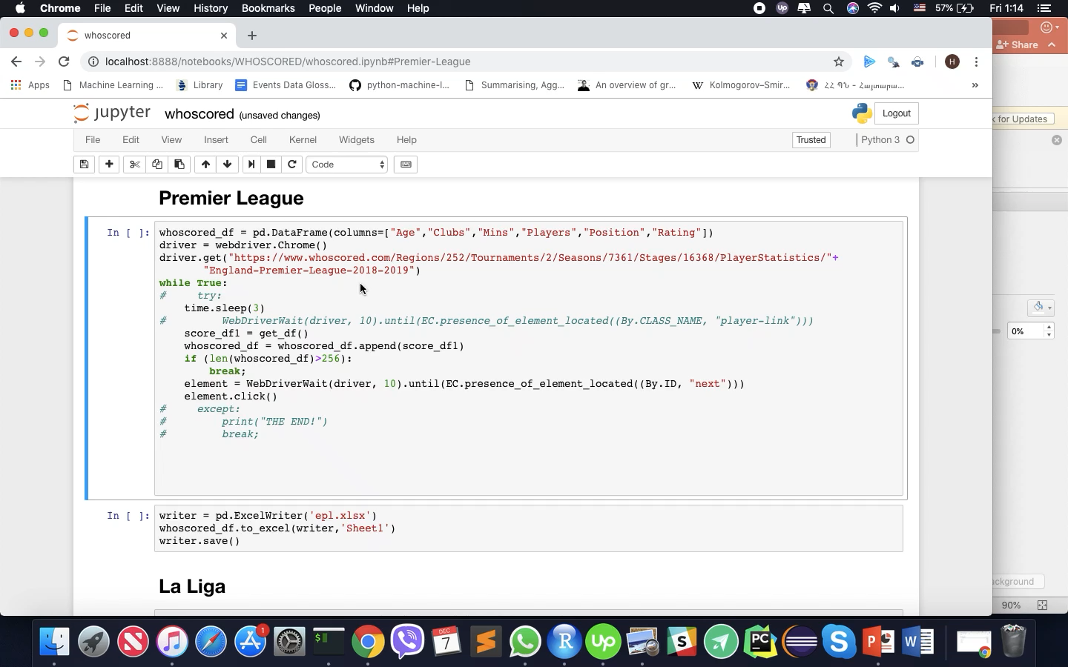

Slide 7
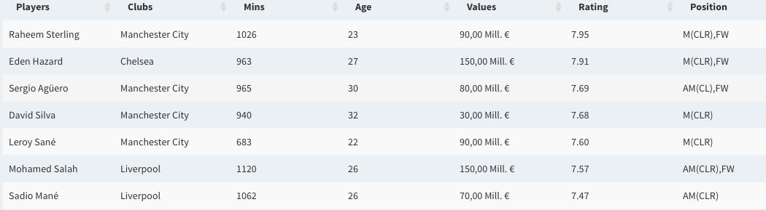
Data Preparation

Slide 8
There are many overvalued and undervalued players
Correlation coefficient between Rating and Price is just 0.42

Slide 9
Optimization
The objective function:

Slide 10
Optimization
The objective function:
Maximize the overall rating of the club

Slide 11
Optimization
The objective function:
Maximize the overall rating of the club
Constraints:

Slide 12
Optimization
The objective function:
Maximize the overall rating of the club
Constraints:
Overall price of the squad <= Your budget

Slide 13
Any idea?
Familiar problem?

Slide 14
The Knapsack problem (0/1)
Given a set of items, each with a weight and a value, determine the number of each item to include in a collection so that the total weight is less than or equal to a given limit and the total value is as large as possible.

Slide 15
Problems in our case
Item limit (The squad consists of 11 players)
Limits on each position (4-4-2)
Time complexity is exponential

Slide 16
Solution
Find the weight in price for each position
Divide your budget for each position accordingly
Subset the data frames
Solve multidimensional Knapsack problem using dynamic programming

Slide 17
Shiny Application
https://henosergoyan.shinyapps.io/squad_builder/

Slide 18
Thank you for attention
For suggestions: henrik_sergoyan@edu.aua.am

